Slide 1


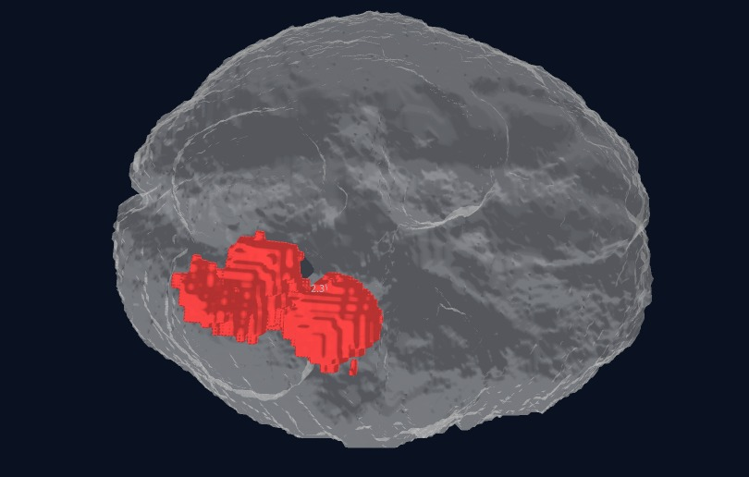
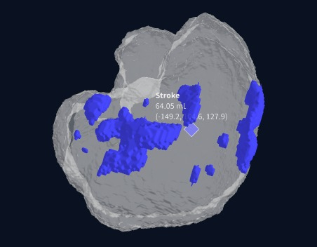
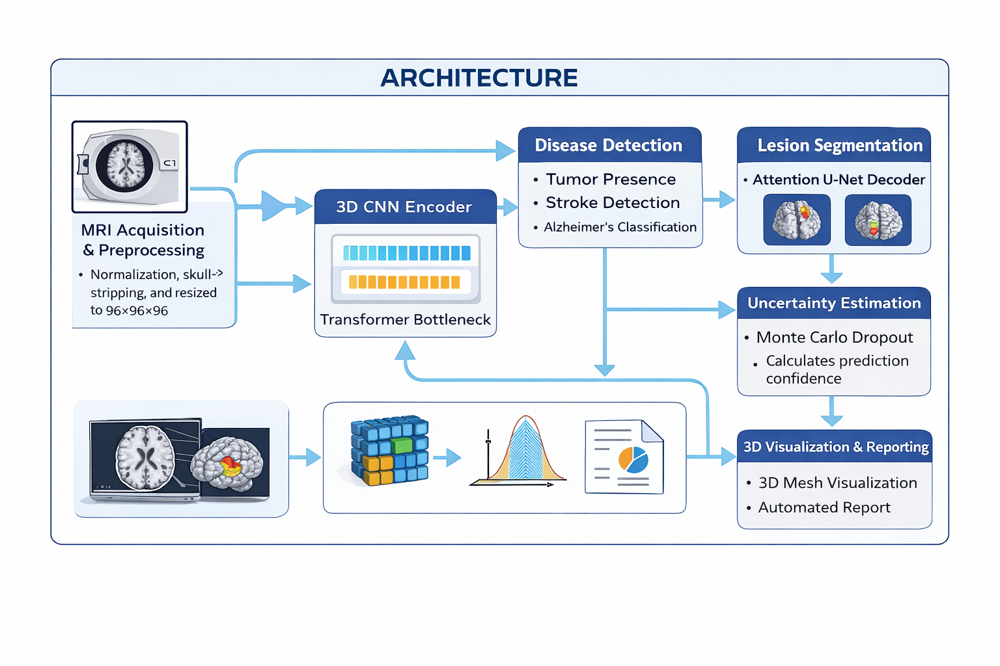
Neurox 3D Neurological Brain Segmentation
Team Members:
Sandireddy Manideep (22BCE1434)
Munta Sai Karthik (22BCE5060)
Gotam Sai Varshith (22BCE1605)
Guide Name: Dr. Jayaram B
School Of Computer Science And Engineering
MOTIVATION / INTRODUCTION
Existing MRI diagnosis systems usually focus on only one neurological disease at a time.
Doctors often need multiple separate tools for tumor, stroke, and Alzheimer analysis.
Many AI models do not provide confidence or uncertainty information for clinical decisions.
NeuroX was developed to create a single unified system for multi-disease detection, segmentation, and automated reporting.
SDG GOAL NUMBER: 3
SDG Goal 3 – United Nations Good Health and Well-Being
OBJECTIVES
Develop a unified AI-based system for analysing brain MRI scans.
Detect multiple neurological disorders including brain tumor, stroke, and Alzheimer’s disease.
Apply MRI preprocessing techniques such as normalization and skull stripping for standardized input.
Extract deep volumetric features using 3D CNN and transformer-based architecture.
Perform accurate lesion segmentation for abnormal brain region localization.
Generate confidence-aware predictions and automated diagnostic reports.
SCOPE OF THE PROJECT
NeuroX is designed to analyze brain MRI scans for multiple neurological disorder detection within a single AI framework.
It supports tumor segmentation, stroke lesion identification, and Alzheimer’s classification with confidence estimation.
The system can be extended for clinical deployment, additional brain diseases, and hospital workflow integration.
It also enables 3D visualization and automated report generation for easier clinical interpretation
METHODOLOGY
MRI Acquisition & Preprocessing
Brain MRI scans are loaded, normalized, skull-stripped, and resized to 96×96×96 for uniform input.
Input Routing
Different MRI modalities are routed based on disease type (tumor, stroke, Alzheimer’s).
Feature Extraction
A 3D CNN encoder extracts volumetric spatial features from MRI data.
Global Context Learning
A Transformer bottleneck captures long-range anatomical relationships.
Disease Detection
Separate prediction heads identify tumor, stroke, and Alzheimer’s presence.
Lesion Segmentation
U-Net decoder generates tumor and stroke lesion masks.
Uncertainty Estimation
Monte Carlo Dropout calculates prediction confidence.
3D Visualization & Reporting
Lesions are converted into 3D mesh models and an automated clinical report is generated.
ARCHITECTURE
RESULTS
CONCLUSION
NeuroX successfully integrates tumor, stroke, and Alzheimer’s detection into a single MRI analysis framework
The proposed system combines 3D CNN, transformer bottleneck, and task-specific decoders for multi-disease prediction
Accurate lesion segmentation was achieved for tumor and stroke cases
Uncertainty estimation improved prediction reliability for clinical interpretation
3D visualization and automated reporting enhance practical usability
The system demonstrates strong potential as an AI-assisted neuroimaging tool
CONTACT DETAILS
MAILID: saikarthik5421@gmail.com MOBILE NO: +91 96183 01254
REFERENCES
Menze, B. H., et al. (2015). The multimodal brain tumor image segmentation benchmark (BRATS). IEEE Transactions on Medical Imaging.
Winzeck, S., et al. (2018). ISLES: Ischemic stroke lesion segmentation benchmark. Frontiers in Neurology.
Jack, C. R., et al. (2008). Alzheimer’s Disease Neuroimaging Initiative (ADNI): MRI methods. Journal of Magnetic Resonance Imaging.

